Slide 1
Chongqing University of Technology
ATAI
Advanced Technique of Artificial Intelligence
Chongqing University of Technology
Adversarial Separation Network for Cross-Network Node Classification （CIKM_2021）
Xiaowen Zhang
Yuntao Du
zhangxw@smail.nju.edu.cn
duyuntao@smail.nju.edu.cn
State Key Laboratory for Novel
Software Technology at Nanjing
University
Nanjing, Jiangsu, China
Rongbiao Xie
State Key Laboratory for Novel
Software Technology at Nanjing
University
Nanjing, Jiangsu, China
rongbiaoxie@smail.nju.edu.cn
Chongjun Wang
State Key Laboratory for Novel
Software Technology at Nanjing
University
Nanjing, Jiangsu, China
chjwang@nju.edu.cn
2022.1.16 • ChongQing
Reported by Lele Duan
Code & dataset:https://github.com/yuntaodu/ASN

Slide 2
Chongqing University of Technology
ATAI
Advanced Technique of Artificial Intelligence
Chongqing University of Technology
1.Background
2.Method
3.Experiments

Slide 3
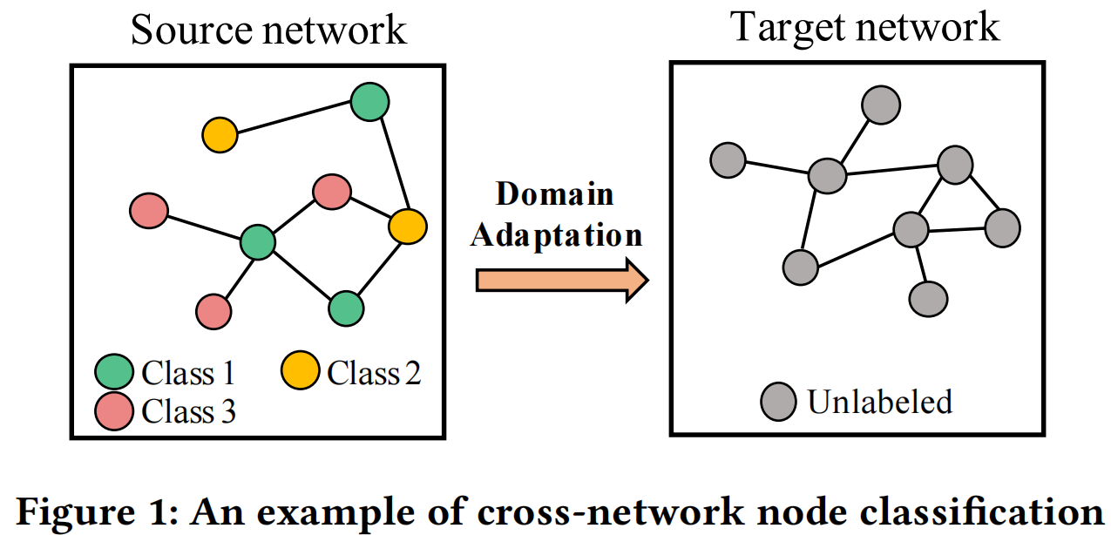
Background
Only focusing on domain-invariant features, ignoring the individual features of each network.
Designing a private encoder for each network and a shared encoder across networks, and force the two encoders to extract different features.
Only utilizing 1-hop neighborhood information (local consistency), ignoring the global consistency information.
Dual GCN framework.

Slide 4
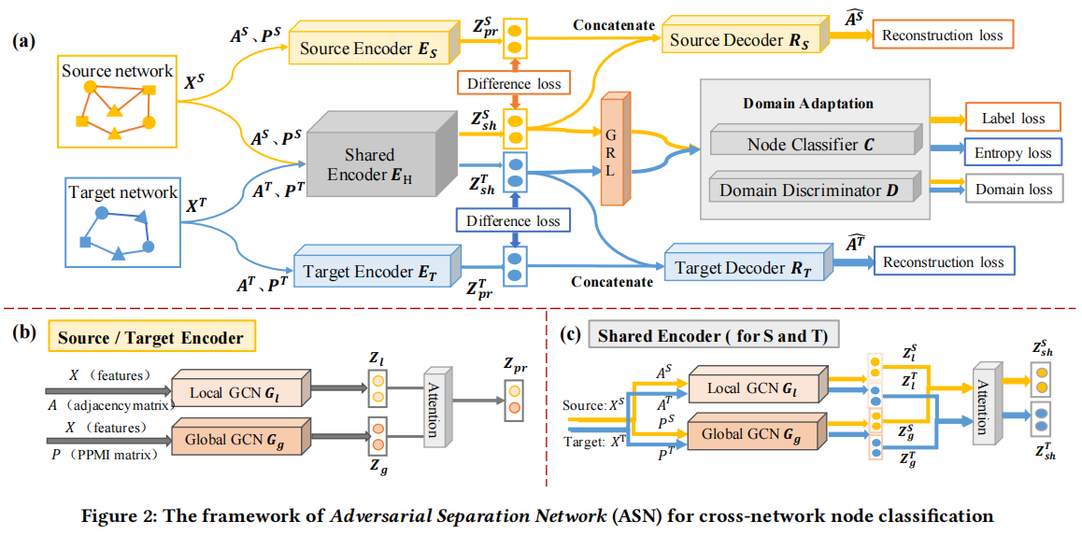
Method
Over view

Slide 5
Method
Difference Loss
Reconstruction Loss

Slide 6
Method
Local and Global Node Representation
Local GCN.
Global GCN
Attention

Slide 7
Method
Cross-Network Node Classification
Node Classification Loss
Entropy Loss
Adversarial Domain Adaptation

Slide 8
Experiment

Slide 9
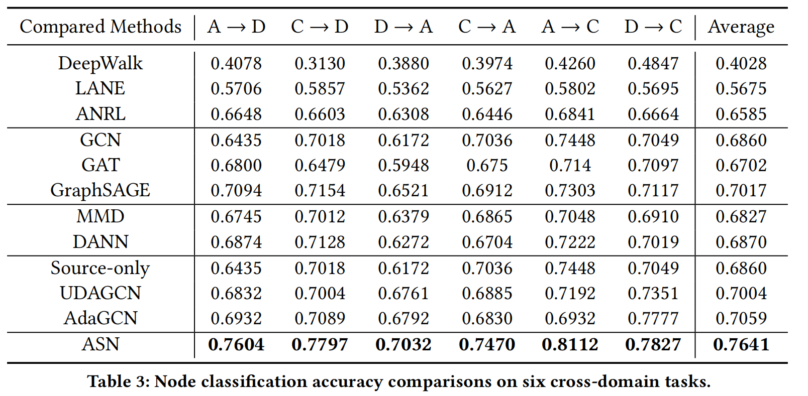
Experiment

Slide 10
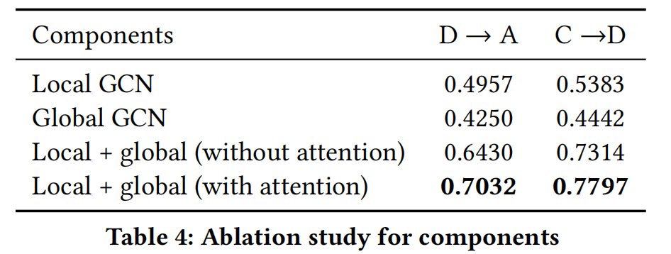
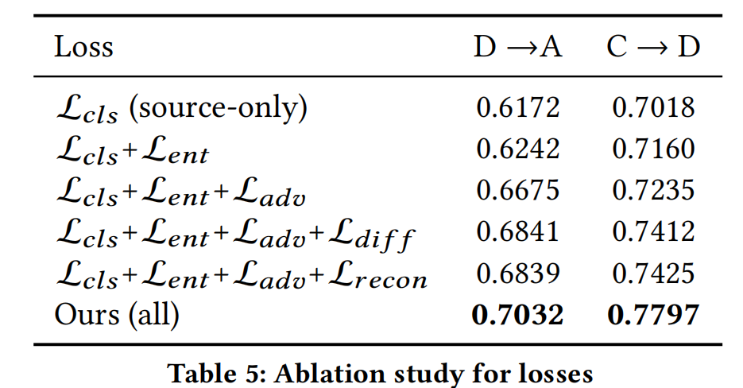
Experiment

Slide 11
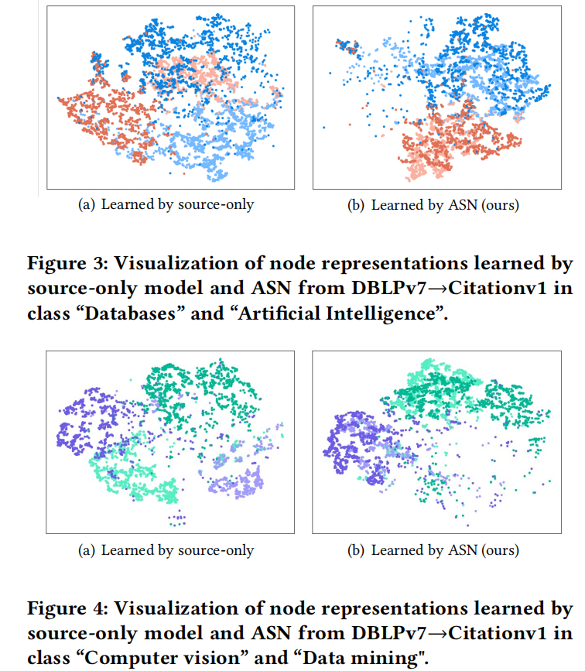
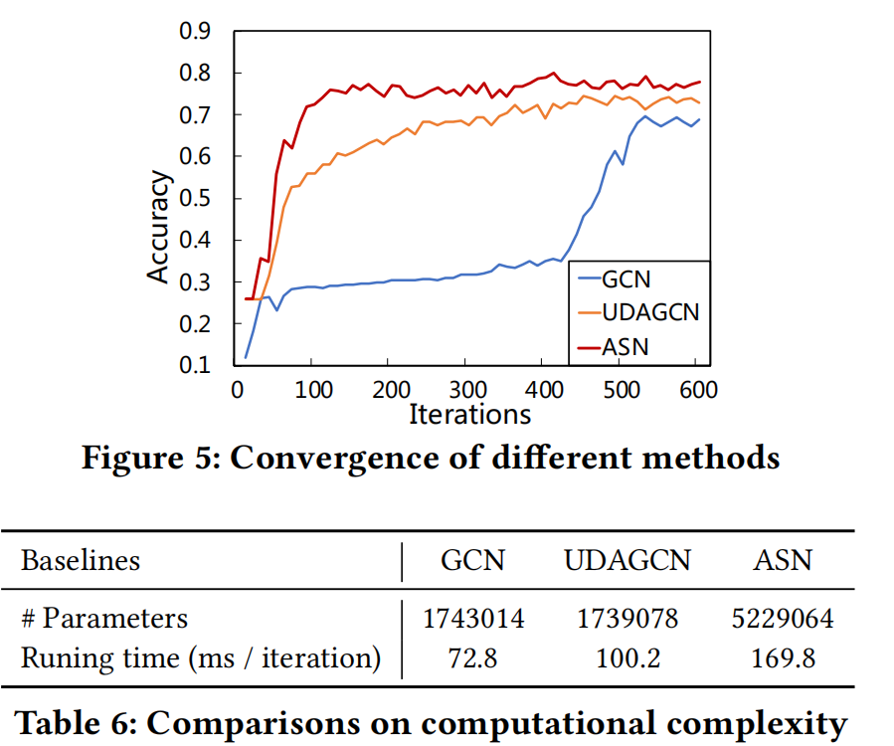
Experiment

Slide 12
Chongqing University of Technology
ATAI
Advanced Technique of Artificial Intelligence
Chongqing University of Technology
Thank you!

